Slide 1
Predicting and Visualizing Breast Cancer diagnosis

Slide 2
What?
Data description
Visualization
Analyzing
Prediction algorithms

Slide 3
Data Description
Numerical dataset
Each row represents a patient
Column represents mean, SE... of radius, area, concavity…
Size (33 Variables and 567 Observations)
.csv file

Slide 4
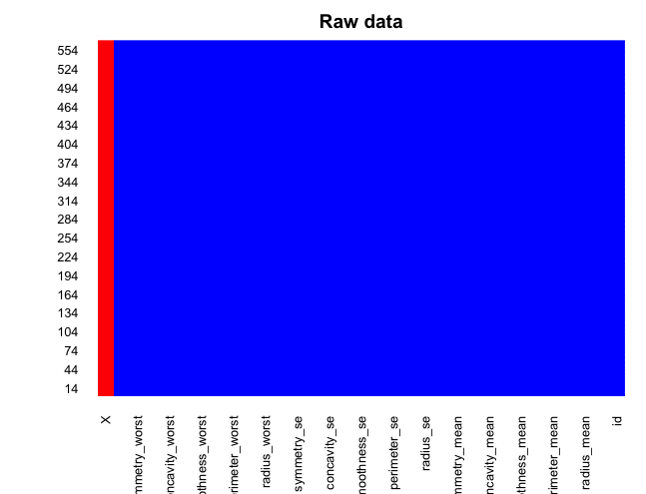

Before and After Cleaning the data

Slide 5
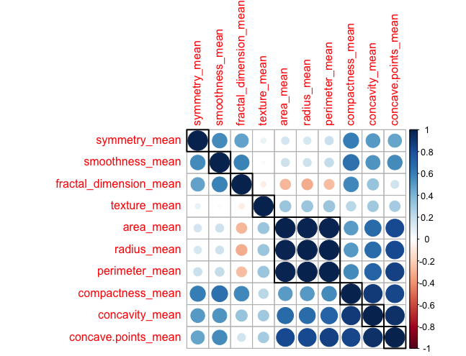
Correlation

Slide 6
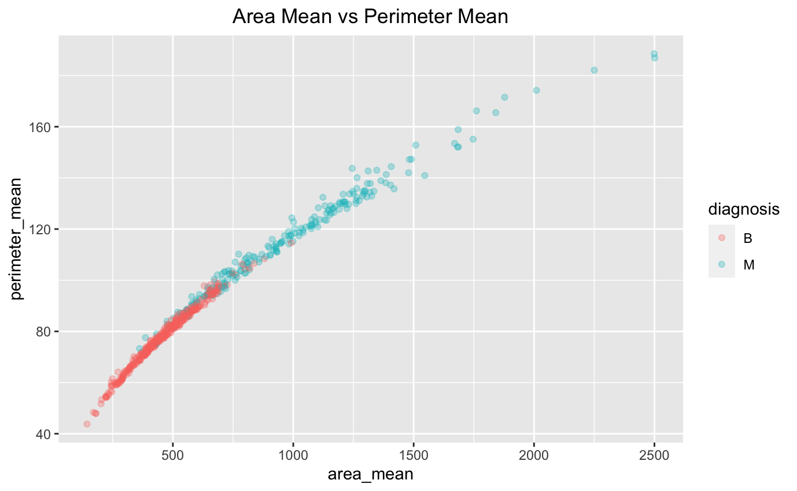
Highly correlated variables

Slide 7
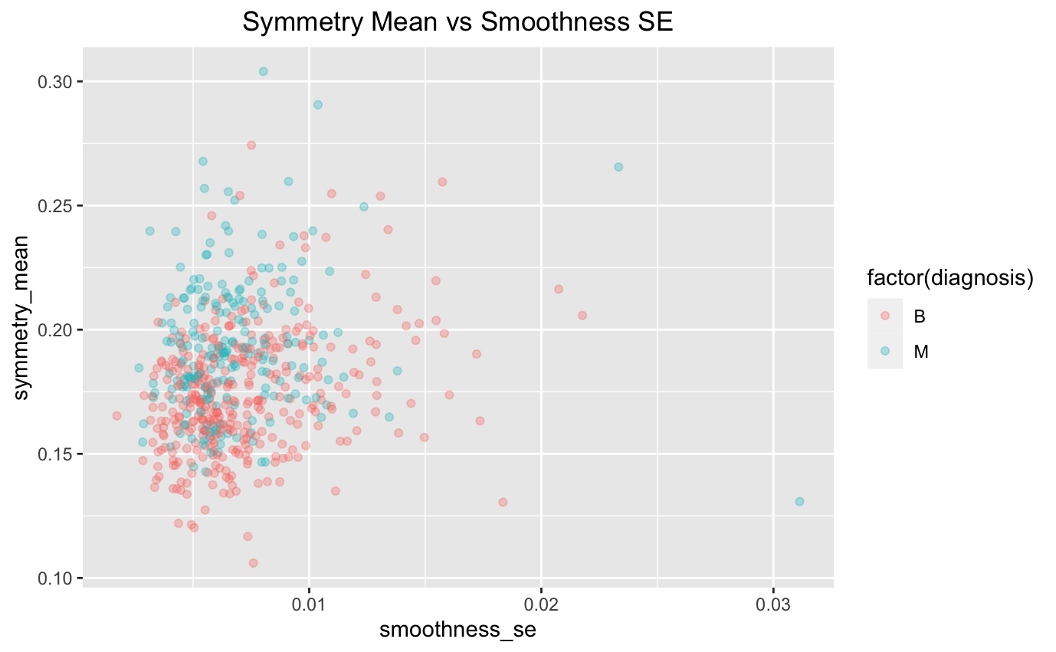

Slide 8
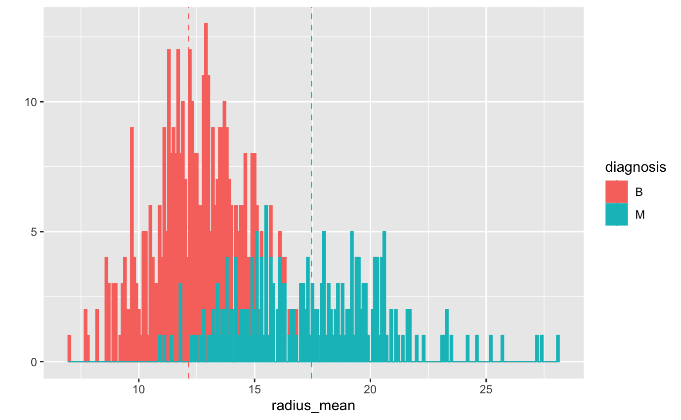
Radius_mean data

Slide 9
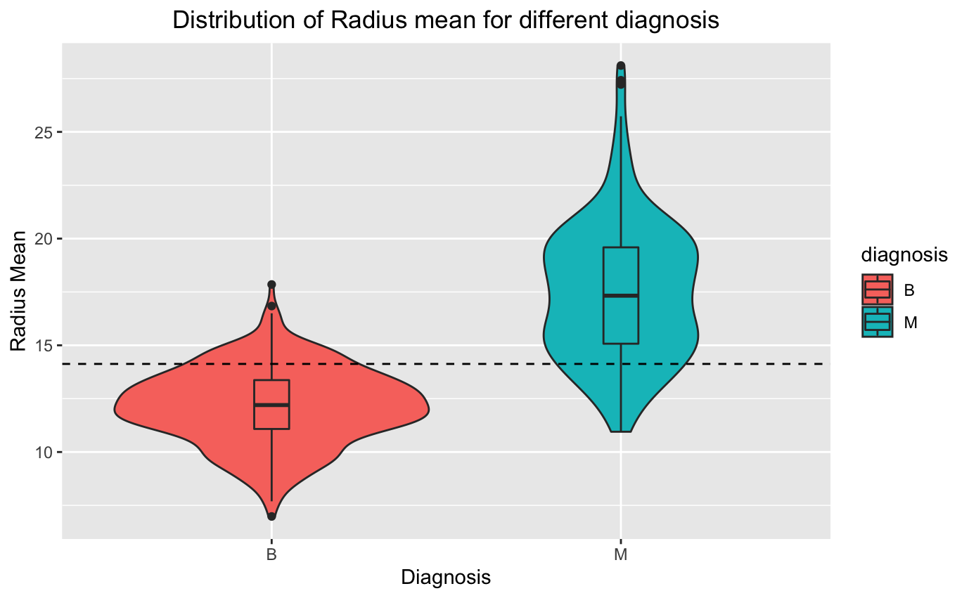
Radius_mean distribution

Slide 10
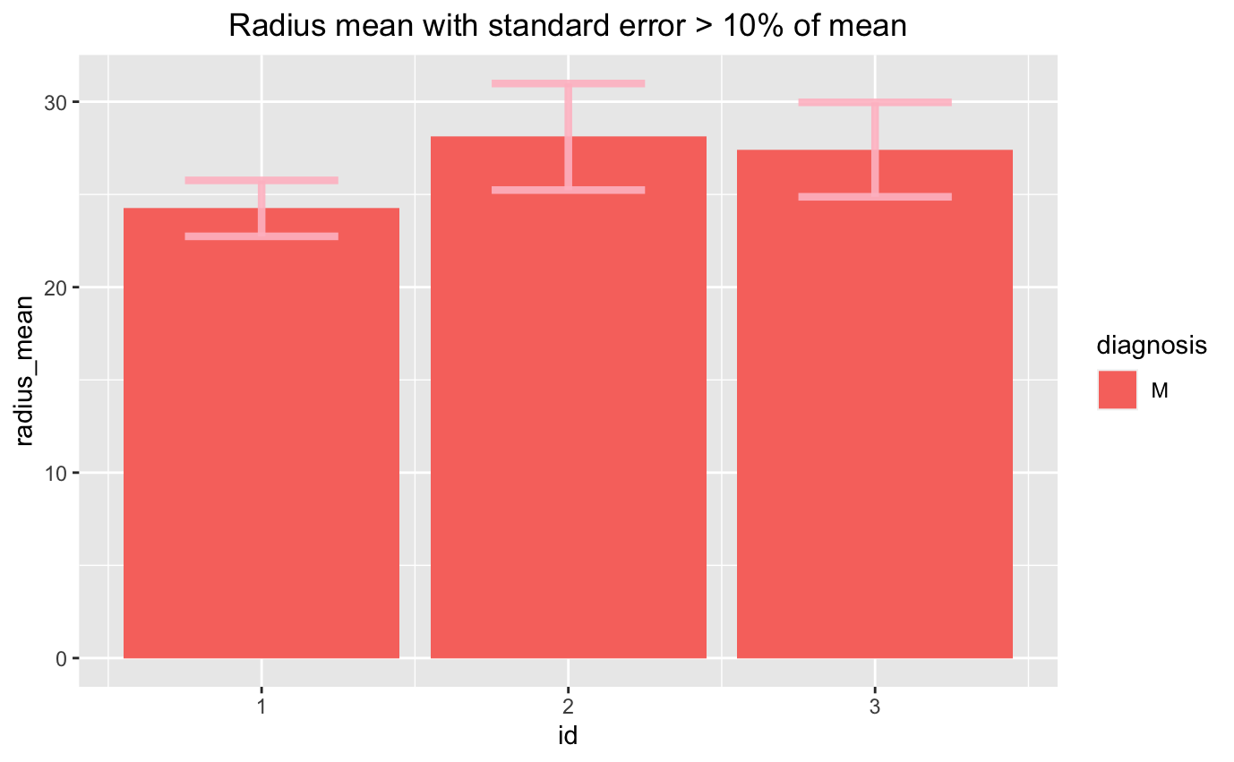
Radius_mean error viz

Slide 11
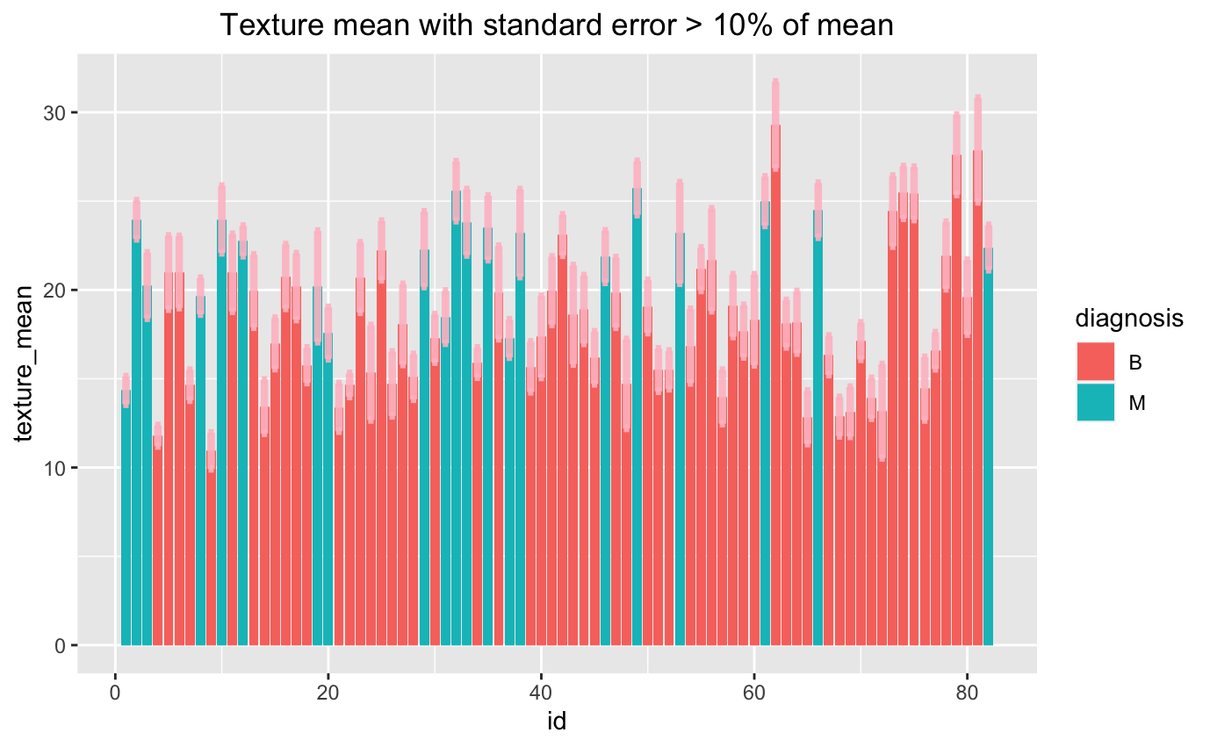
Texture error viz

Slide 12
Predicting algorithms
Test set: 30% Training set: 70%
Logistic regression
KNN
Random Forest
Neural networks

Slide 13
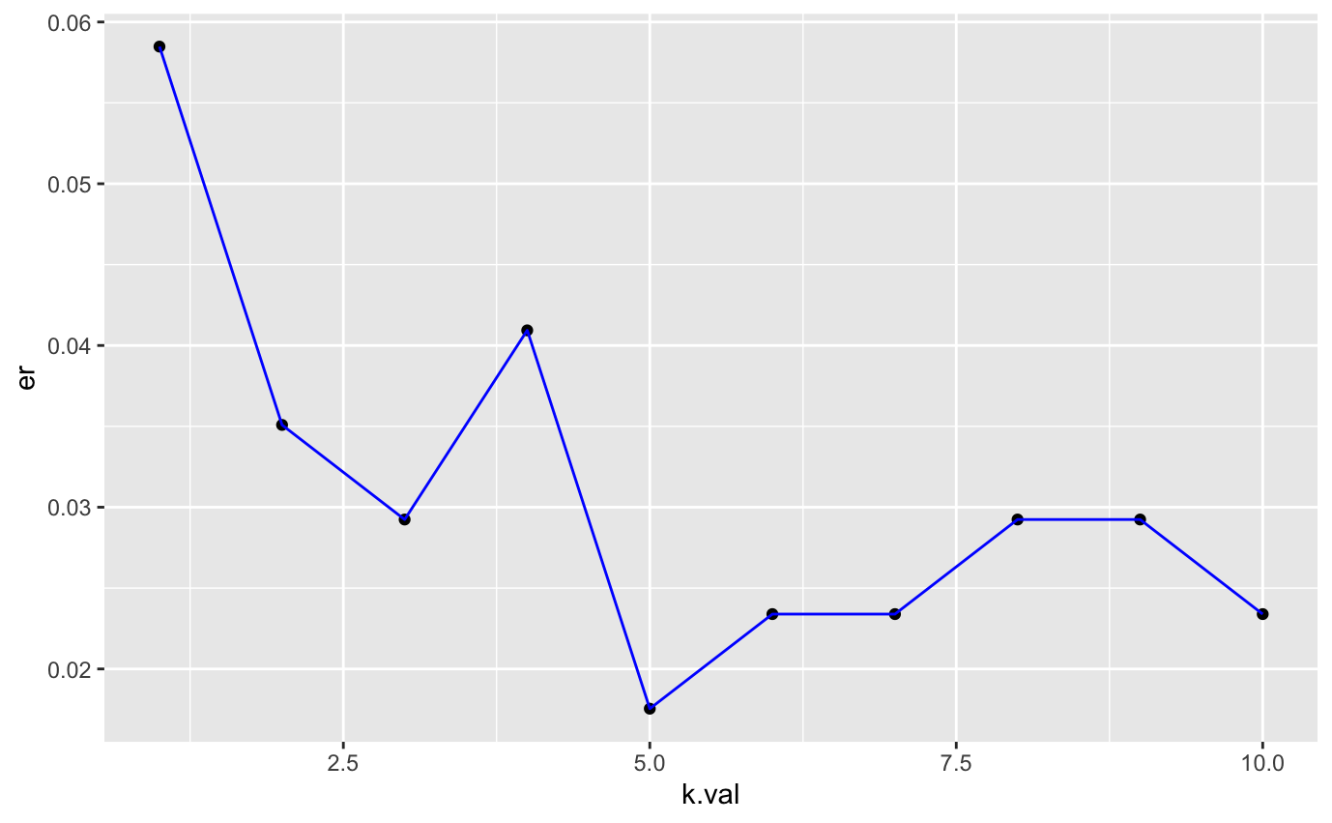
KNN

Slide 14
Results
Models | Efficiency in %
Logistic Regression | 95.32
KNN | 98.24
Random Forest | 95.32
Neural Network | 96.49

Slide 15
References
UC Irvine Machine Learning repository
r/dataisbeautiful

Slide 16
?

